Slide 1
Community Land Banking
English
October 2022

Slide 2
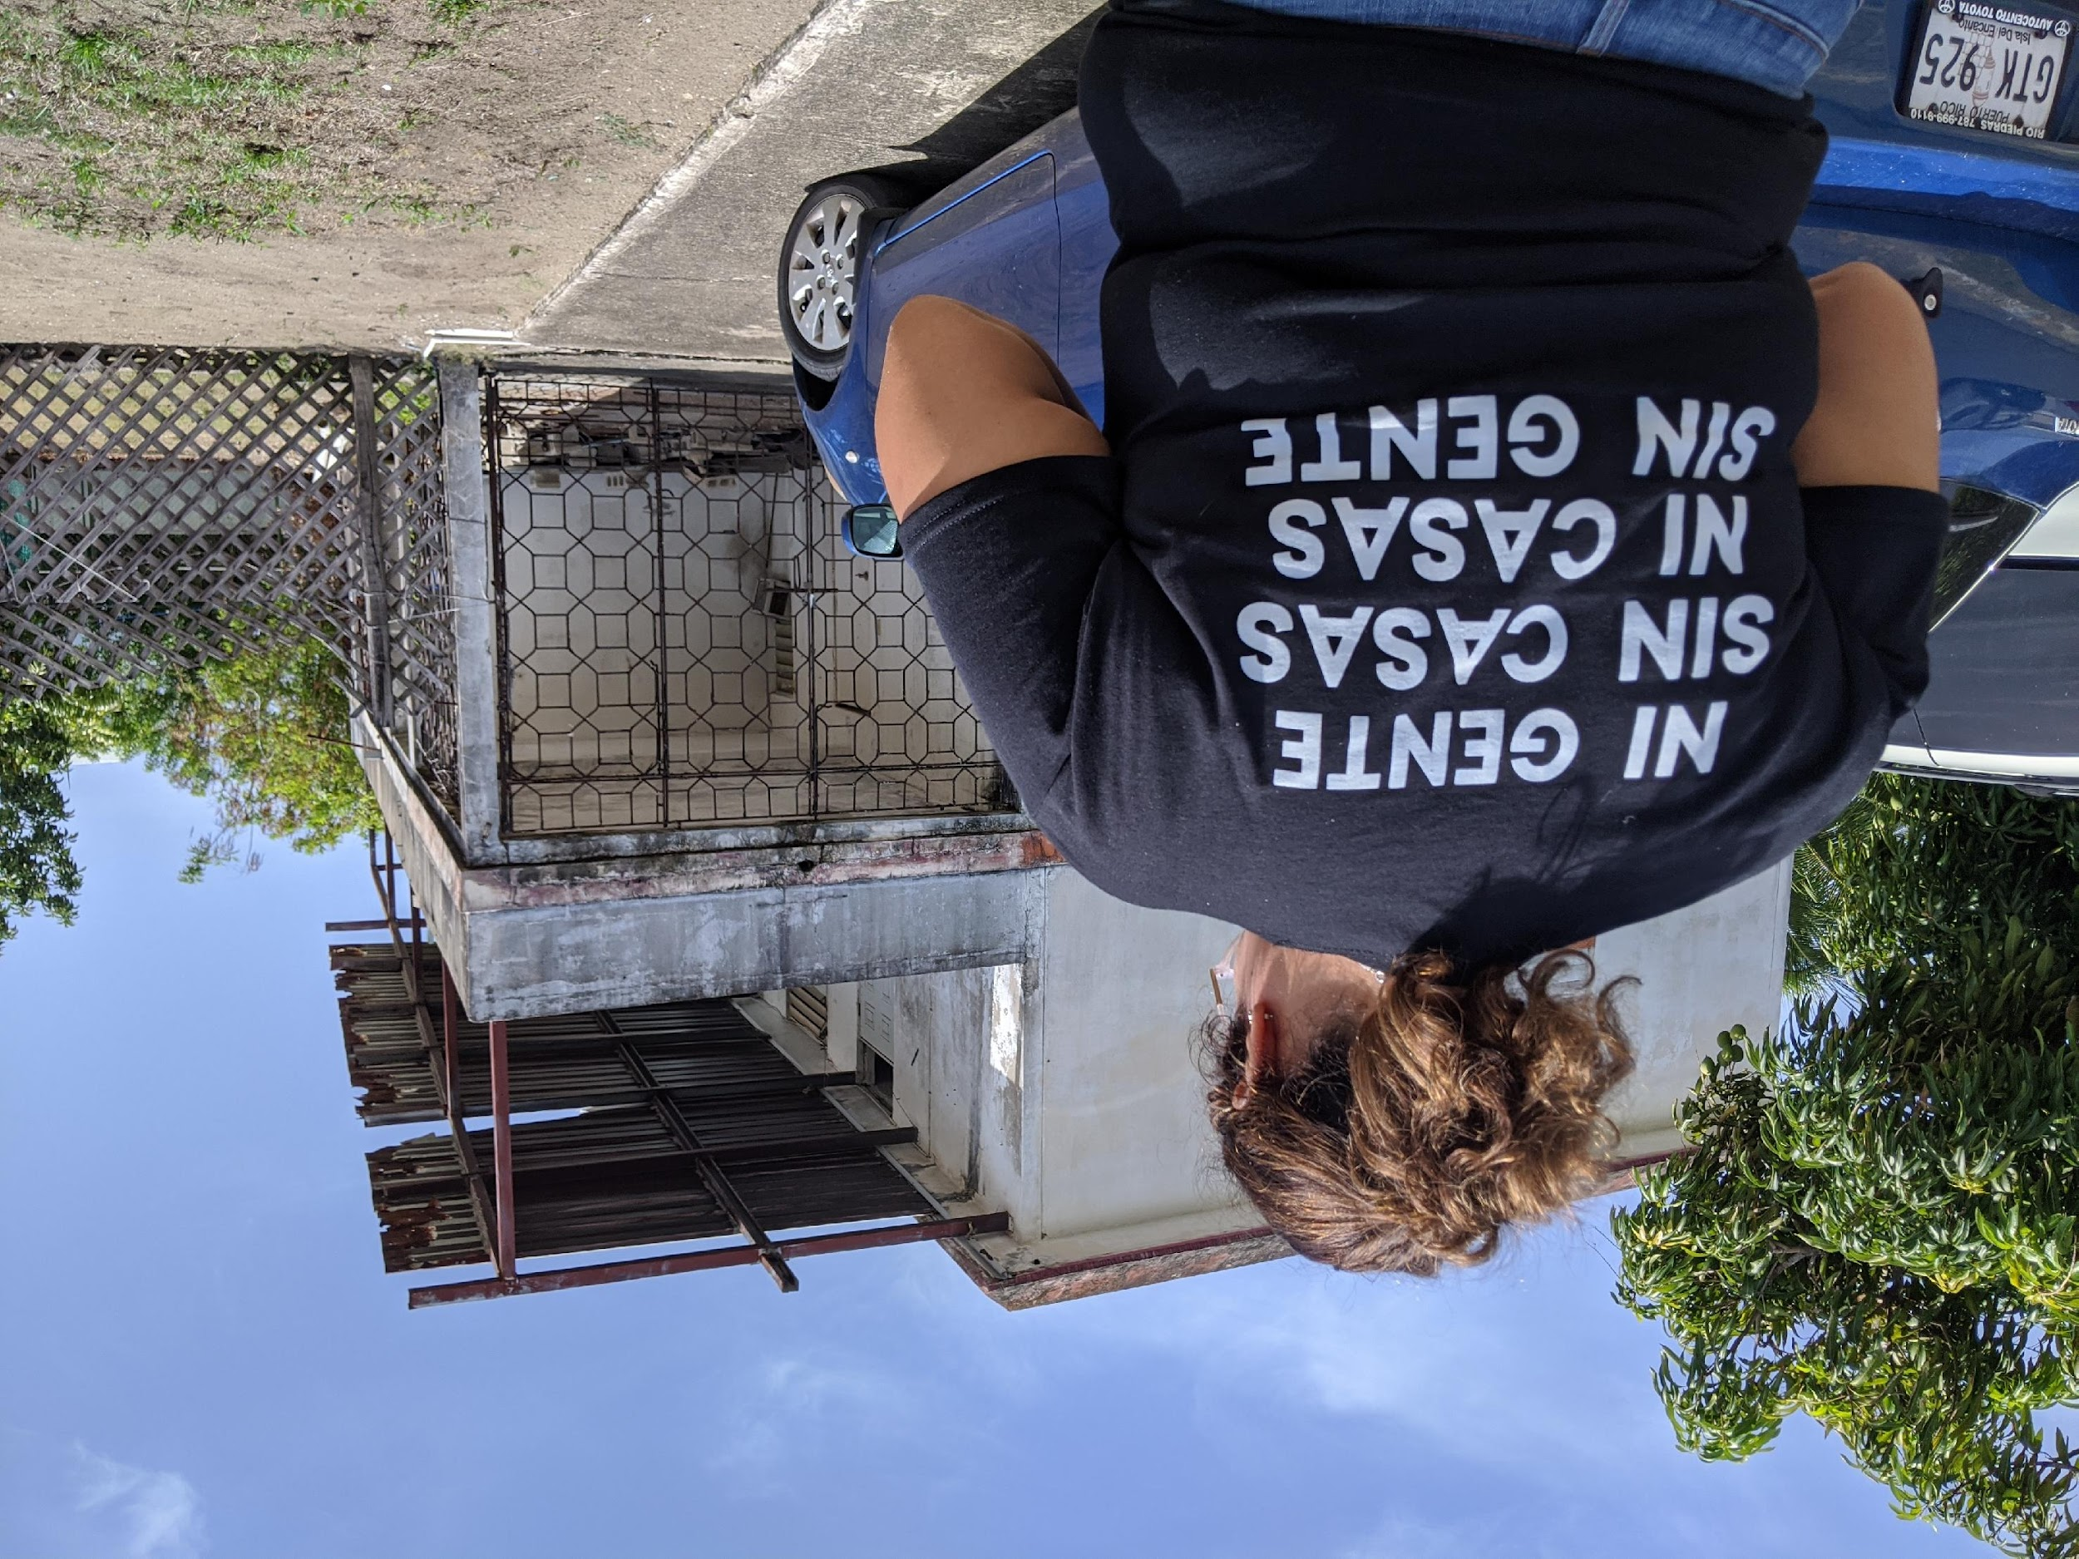
What is CRH?
Centro para la Reconstrucción de Hábitat
Center for Habitat Reconstruction
The only 501(c)(3) non-profit organization in Puerto Rico dedicated exclusively to stopping the problem of blighted and abandoned properties, with a comprehensive cross-sector approach.

Slide 3
How is “Community Land Bank” translated to Spanish?
“Banco comunitario de tierras” o “Banco de tierras comunitarias”

Slide 4
What is a land bank?
180+ land banks across the US
80% established since 2008
80% exist by state legislation
The largest land banks are in the states of Michigan, Ohio, New York, Pennsylvania, and Georgia.
Not every bank or feature is the same

Slide 5
What does the land bank do?
Acquires property in a cost-effective manner
Clears liens and titles
Custodies real property without paying taxes
Generate and collect revenue through penalties, tax collection or other mechanisms
Disposes of property in a flexible manner and not limited to the highest cost
Separates acquisition and disposition of real estate from political "back and forth”

Slide 6
What else does the land bank do?
Governed by a Board of Directors
Often have Advisory Boards composed of community representatives.
Acquire properties through different sources:
Execution of tax debts - 71%
Private market - 12
Donation - 7% Other - 9% Other - 9% Other - 9% Other
Other - 9%
They can also dispose of properties through different methods or join with a developer as a partner.

Slide 7
When is it necessary?
Loss of population and high unemployment rates
Poor economic conditions and under-market properties
Flaws in the tax system or in code enforcement
Municipal restrictions on property disposition protocols
Increased incidence of natural disasters
Lack of a community-based, equitable and pro-community resilience approach

Slide 8
Case in point:
Culebra, Puerto Rico
As an area of tourist interest, a Public Nuisance Management Program or code compliance may result in the displacement of residents due to speculation, increases in acquisition costs and proliferation of short-term rentals.

Slide 9
Case in point:
Culebra, Puerto Rico
As an area of tourist interest, a Public Nuisance Management Program or code compliance may result in the displacement of residents due to speculation, increases in acquisition costs and proliferation of short-term rentals.

Slide 10
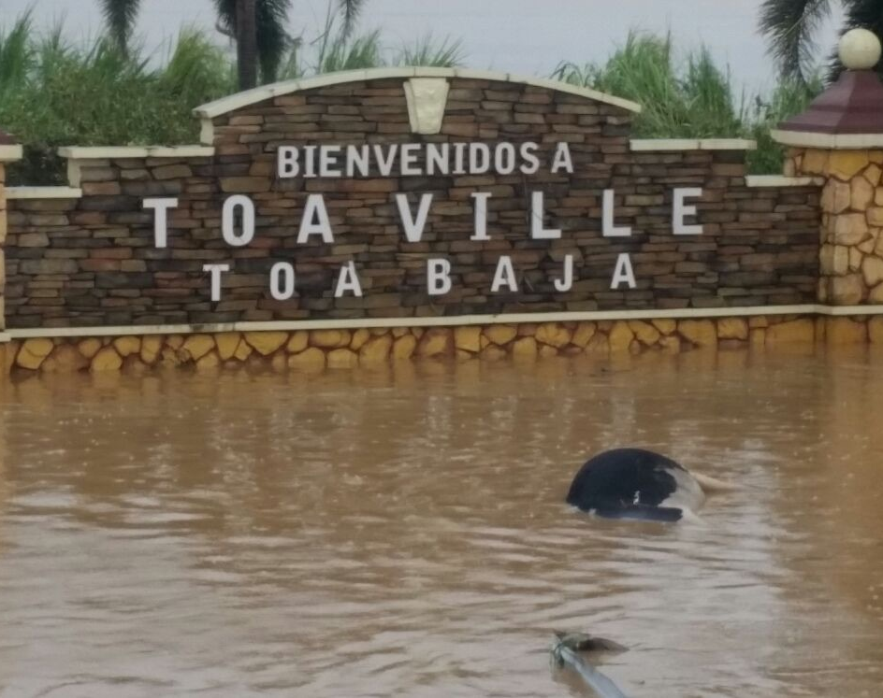
Case in point:
Toa Baja, Puerto Rico
The community of Toa Ville in Toa Baja, is within a flood zone where the level of water can reach several feet in height. Nonetheless, the state and federal government are in the process of undertaking a massive mitigation project that will lower the flooding rate by 80%. Without a land bank, residents may be displaced to increase the value of post-mitigation properties.

Slide 11
Case in point:
Toa Baja, Puerto RICO
The community of Toa Ville in Toa Baja, is within a flood zone where the level of water can reach several feet in height. Nonetheless, the state and federal government are in the process of undertaking a massive mitigation project that will lower the flooding rate by 80%. Without a land bank, residents may be displaced to increase the value of post-mitigation properties.

Slide 12
Examples of methods and strategies
Eliminate
deterioration
Maximize
short term
income
Maximize
long term
Income
Housing/
Commerce
affordable
Stabilize
neighborhood
Demolition/
rehabilitation
Sale to
higher
bidder
Transfer
to
re-development
Transfer
at the lowest
cost
Demolish/
transfer
to the adjoining

Slide 13
Legal Framework in Puerto Rico
Act No. 107-2020
Creates a legal framework for the creation of Land Banks by municipalities.
They are "municipal corporations".
It is generic, which can be a good and bad thing at the same time.
Challenges in legislature:
It sounded "nice" but they didn't understand it.
They wanted it to be for-profit rather than non-profit.
It is part of a broader Municipal Code, which made it difficult to make the issue visible.
Minimizes the role of the Advisory Council.

Slide 14
From P.S. 1676 to Act 107-2022
The passage of Act 107 and particularly its chapter on Land Banks took four years of intense advocacy. CRH and its staff met with dozens of mayors, legislators, and other stakeholders.

Slide 15
Challenges and advice on the creation
Legislatures or municipal councils may have reservations with "releasing power" over what they perceive to be their assets.
As a municipal corporation, it must report its activities to the state government.
As a non-profit entity, it must have its state and federal exemptions (501c3).
As a non-profit entity, it can incorporate with a group of incorporators.

Slide 16
Challenges and advice on the first meeting
Bureaucracy and slow appointment processes.
Recruitment of people for all-volunteer positions.
Recruitment of diverse population groups, in terms of demographics and background.
The "politicking" at the time of selecting candidates.

Slide 17
Implementation challenges
It is still experimental and may result difficult for a mayor or city council to trust.
Allocation of funds for the launching and operation of the Land Bank.
Repair of the the first homes.
Absence of an ecosystem of collaborators (from construction to financing).
The sale of "as is" properties does not promote affordable housing and is also risky.

Slide 18
Advice on implementation
Begins with a small number of properties.
Selects those that undergo long periods of vacancy, carry high debts and/or pose problematic to the community.
Starts with support from the municipality itself or from civil society partners (such as the example of CRH and Toa Baja).
Select "easy" properties requiring little repair and investment.
Initiates sales projects to capitalize the Bank.
If repairs are not possible at the beginning, explores the possibility of a "deed in escrow" or "deed in trust".

